Slide 1


Anton Sinev
February 2023

Slide 2

Outline
Executive Summary
Introduction
Methodology
Results
Conclusion
Appendix

Slide 3
Executive Summary
Summary of methodologies:
Data collection (SpaceX API, web scrapping);
Exploratory data analysis (SQL, matplotlib, interactive dashboards and maps);
Predictive analysis using ML methods (logistic regression, KNN, SVM and D\decision tree).
Summary of all results
Required data have been collected and processed;
EDA has shown the main dependencies between variables;
Predictive analysis has allowed us to find the best model which can be used for success probability prediction.

Slide 4
Introduction
Project background and context
SpaceX offers Falcon 9 launches at a cost of 62 million dollars, while other providers charge over 165 million dollars. The lower cost of SpaceX is due to their ability to reuse the first stage, making it important to determine its landing success in order to determine the cost of a launch. This information can be used by competitors to bid against SpaceX for rocket launches;
Problems you want to find answers:
Aim of the project is to predict the success of the Falcon 9 first stage landing;
Find key factors affecting on success landing probability.

Slide 5

Section 1

Slide 6
Methodology
Executive Summary
Data collection methodology:
SpaceX data have been collected from 2 sources:
SpaceX API (https://api.spacexdata.com/v4);
Wikipedia (https://en.wikipedia.org/w/index.php?title=List_of_Falcon_9_and_Falcon_Heavy_launches&oldid=1027686922);
Perform data wrangling
After collecting the required data, the landing outcomes were classified into two groups: "good" and "bad"”;
How to build, tune, evaluate classification models

Slide 7
Methodology
Executive Summary
Perform exploratory data analysis (EDA) using visualization and SQL
Perform interactive visual analytics using Folium and Plotly Dash
Perform predictive analysis using classification models
The data gathered to this point was normalized and split into training and testing sets. These sets were then analyzed using four distinct classification models (logistic regression, SVM, decision tree and KNN), with the accuracy of each model evaluated using confusion matrix and accuracy score.

Slide 8
Data Collection
Datasets were collected from two sources:
SpaceX API (“https://api.spacexdata.com/v4/”) – using API requests;
Wiki page (“https://en.wikipedia.org/w/index.php?title=List_of_Falcon_9_and_Falcon_Heavy_launches&oldid=1027686922”) – web scrapping techniques.

Slide 9
Data Collection – SpaceX API
The SpaceX API was used according to the flowchart;
Data collection steps can be found in the Jupyter Notebook.
SpaceX API call
Normalization of .json() response
Raw data processing using the set of functions:
getBoosterVersion;
getLaunchSIde;
getPayloadData;
getCoreData.
Combine the processed data into one dataframe

Slide 10
Data Collection - Scraping
SpaceX launches data were downloaded from the Wiki page using BeautifulSoup library;
Downloaded data were parsed;
Data collection steps can be found in the Jupyter Notebook.
Parse html data using BeatifulSoup
Find the target table using .findall()
Transform rows from the target table to rows of the dataframe

Slide 11
Data Wrangling
Data wrangling consist of the following steps:
Different launch sides were identified. For each launch side the number of launches was calculated;
The set of orbits was defined. For each orbit the number of occurrence was calculated;
The set of possible outcomes was defined. All outcomes were splitted by two groups: “good” (successful) and “bad” (unsuccessful);
All calculation were performed in the Jupyter Notebook.

Slide 12
EDA with Data Visualization
The following EDA techniques were used:
Investigation of dependency between 2 factors:
Payload mass vs Flight number;
Launch site vs Flight number;
Payload mass vs Launch site;
Flight number vs Orbit type;
Payload orbit type;
Investigation of dependency between dependent and independent variables:
Success rate for each orbit;
Success rate yearly trend.
All calculation can be found in the Jupyter Notebook.

Slide 13
EDA with SQL
The following SQL queries were performed:
Display the names of the unique launch sites in the space mission;
Display 5 records where launch sites begin with the string 'CCA’;
Display the total payload mass carried by boosters launched by NASA (CRS);
Display average payload mass carried by booster version F9 v1.1;
List the date when the first successful landing outcome in ground pad was achieved;
List the names of the boosters which have success in drone ship and have payload mass greater than 4000 but less than 6000;
List the total number of successful and failure mission outcomes;
List the names of the booster_versions which have carried the maximum payload mass;
List the failed landing_outcomes in drone ship, their booster versions, and launch site names for in year 2015;
Rank the count of landing outcomes (such as Failure (drone ship) or Success (ground pad)) between the date 2010-06-04 and 2017-03-20, in descending order
Link to the Jupyter Notebook.

Slide 14
Build an Interactive Map with Folium
The following object were added to the Folium map:
Markers with Circle, Popup Label and Text Label of all Launch Sites;
Markers of success (Green) and failed (Red) launches;
Lines to show distances between the Launch Site CCAFC-SLC 40 and various objects: railway, highway, coastline and the city.
The Jupyter Notebook can be found here.

Slide 15
Build a Dashboard with Plotly Dash
The following dashboard elements were added:
Launch sites dropdown list;
Success launches pie chart;
Payload mass slider;
Scatterplot of payload mass vs. success rate.
The Jupyter Notebook can be found here.

Slide 16
Predictive Analysis (Classification)
Model building process consists of the following steps:
The data were standardized using StandardScaler();
The dataset was split by training and testing ones;
Four different models were built:
Logistic regression with L2-regularization;
SVM;
Decision tree;
KNN;
Accuracy of models was estimated on training and testing datasets;
The Jupyter Notebook can be found here.

Slide 17
Results
Exploratory data analysis results;
Percentage of successful launches from VAFB SLC 4E is the highest;
For some orbits (e.g. LEO) there is a dependency between flight number and outcome. For other ones (e.g. GTO) this dependency is not observed;
The success rate increasing over time;
There are 4 unique launch sites;
The first success landing outcome happened in 2015;
Interactive analytics demo in screenshots
Predictive analysis results

Slide 18
Results
The most launch sites are at east cost.

Slide 19
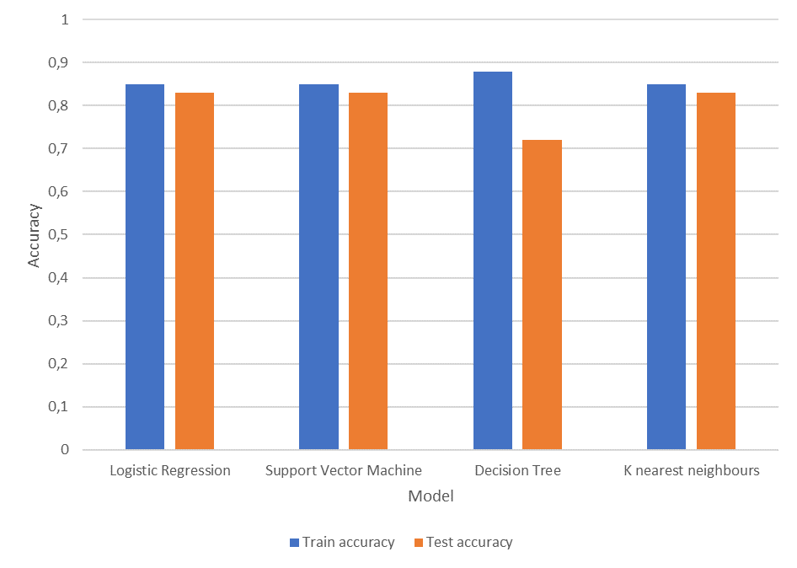
Results
The predictive analysis shows that there are 3 models with the same train/test accuracy: Logistic regression, SVM and KNN. Decision tree has the higher train accuracy but the lower test accuracy.

Slide 20

Section 2

Slide 21
Flight Number vs. Launch Site
Conclusions:
In contrast with the first flight, last flights were successful;
Most of the launches took place at CCAFS SLC 40 launch site.

Slide 22
Payload vs. Launch Site
Conclusions:
The higher payload mass the higher success rate;
VAFB SLC 4E is not used for heavy launches;
Light launches are successful from KSC LC 39A site.

Slide 23
Success Rate vs. Orbit Type
Conclusions:
The highest success rate (100%) is observed for “ES-L1”, “GEO”, “HEO” and “SSO” orbits;
The lowest rate is observed for “GTO” orbit.

Slide 24
Flight Number vs. Orbit Type
Conclusions:
“GTO” was the most popular orbit at the beginning;
“VLEO” is the most popular orbit now;
For almost all orbits (excl. “GTO”) success rate is increasing.

Slide 25
Payload vs. Orbit Type
Conclusions:
Heavy launches are related to “ISS”, “PO” and “VLEO” orbits;
Payload mass of “GTO” launches are between 2000 and 8000.

Slide 26
Launch Success Yearly Trend
Conclusions:
Success rate is increasing starting from 2013.

Slide 27
All Launch Site Names
Names of the launch sites

Slide 28
Launch Site Names Begin with 'CCA'
5 records where launch sites begin with `CCA`

Slide 29
Total Payload Mass
The total payload mass carried by boosters launched by NASA (CRS)

Slide 30
Average Payload Mass by F9 v1.1
The average payload mass carried by booster version F9 v1.1

Slide 31
First Successful Ground Landing Date
Date of the first successful landing outcome on ground pad

Slide 32
Successful Drone Ship Landing with Payload between 4000 and 6000
The names of boosters which have successfully landed on drone ship and had payload mass greater than 4000 but less than 6000

Slide 33
Total Number of Successful and Failure Mission Outcomes
The total number of successful and failure mission outcomes

Slide 34
Boosters Carried Maximum Payload
Names of the booster which have carried the maximum payload mass

Slide 35
2015 Launch Records
Failed landing_outcomes in drone ship, their booster versions, and launch site names in 2015

Slide 36
Rank Landing Outcomes Between 2010-06-04 and 2017-03-20
Ranking the count of landing outcomes between the date 2010-06-04 and 2017-03-20 in descending order.

Slide 37

Section 3

Slide 38
Launch site's location
Launch sites are placed on the South of USA near the coastline.

Slide 39
Number of launches on each site
Most of the launches were from the east coast.

Slide 40
Distances to the nearest objects
The launch sites are close to the roads and coastline, but relatively far from the city.

Slide 41

Section 4

Slide 42
Success launches by site
Most of the success launches are started from KSC LC-39A

Slide 43
KSC LC-39A – success launches
Approximately ¾ of all launches started from the most popular site were successful.

Slide 44
Payload mass
Booster v1.1 has high success rate;
Most of the failed launches are within (4000, 6000) kg range.

Slide 45

Section 5

Slide 46
Classification Accuracy
In the bar chart you can see the results of model's comparison;
Logistic Regression, SVM and KNN models have the same train and test accuracy scores;
Decision tree has the highest accuracy score on the train sample but on the test sample it decreases and becomes the lowest one.

Slide 47
Confusion Matrix
Confusion matrices are the same for all 3 best models;
False negative rate is 0%;
False positive rate is 50%, which is relatively high.

Slide 48
Conclusions
Logistic Regression, SVM and KNN models give the same results with the same accuracy score;
Launch success rate increases over time;
Orbit may have significant influence on launch outcome;
Most of the launches are started in South states (California, Florida), most likely because they are closer to Equator than the other ones.

Slide 49
Appendix
All project details can be found in the following GitHub repo: https://github.com/110-283/IBM_Data_Scientist/tree/main/10.%20Applied%20Data%20Science%20Capstone.

Slide 50


